Slide 1
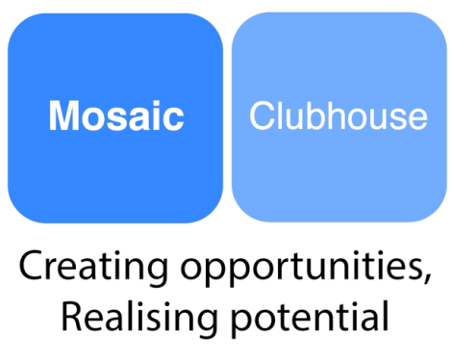

Mosaic Clubhouse
Reaching Out

Slide 2
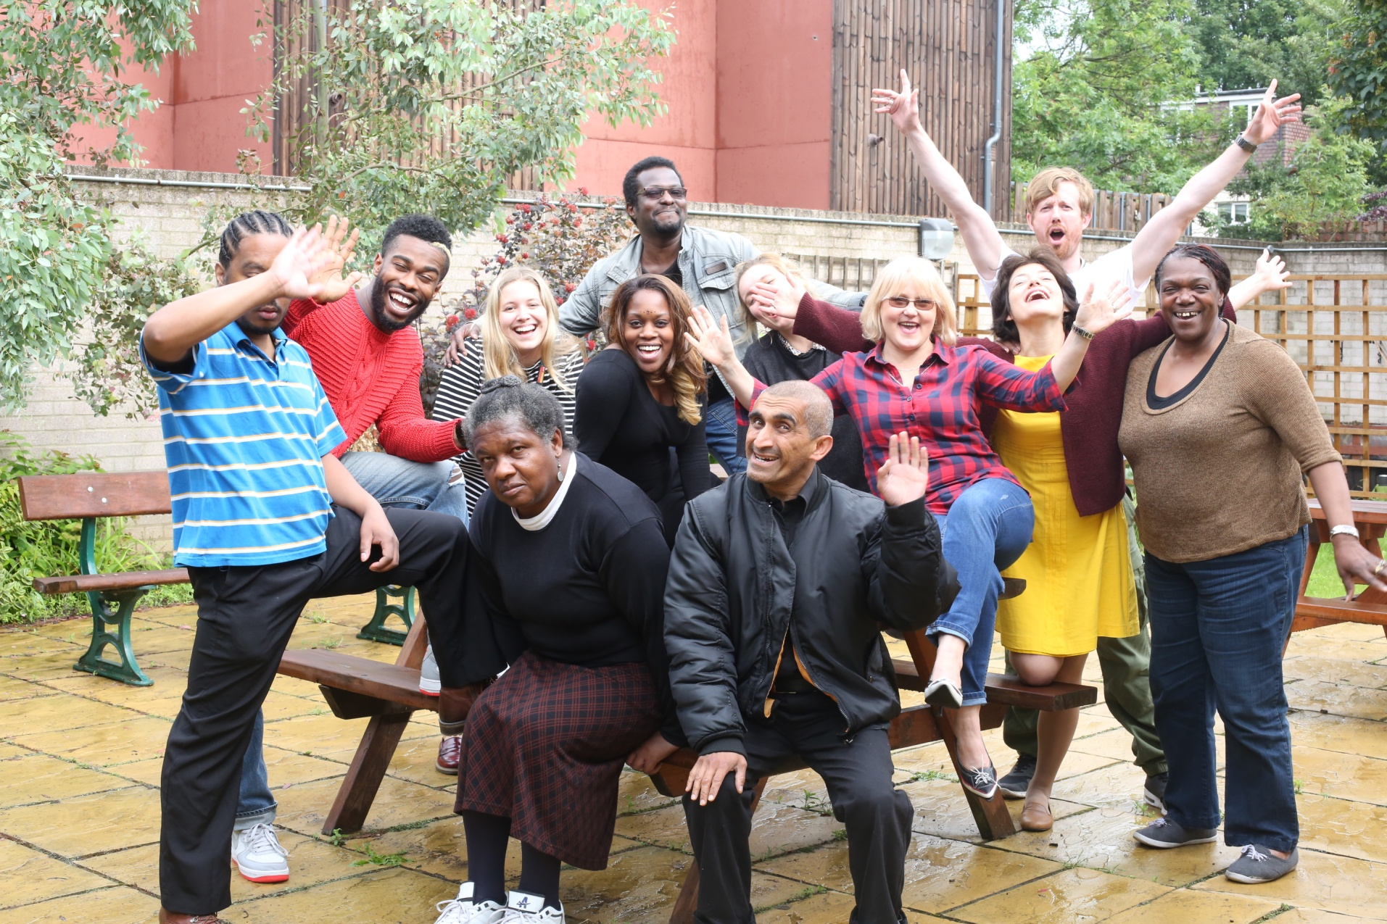
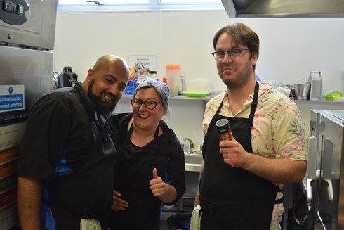
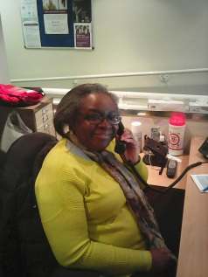
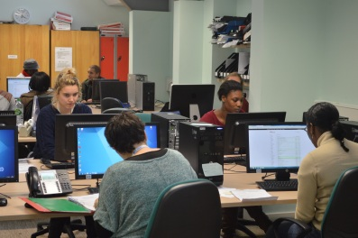
Adapting & Keeping Connected
All Staff working remotely
Reach out - 400 Members phone call daily or once per week.
Email, Text
Zoom one-to-one with members
Postcards
Info Hub
Evening Sanctuary
Mosaic & Sanctuary Referrals
Outreach/Befriending?
Mosaic Information Hub Phone or Text: 07984 343 643.
Email: infohub@mosaic-clubhouse.org
Notes:
How Staff are now Supporting Members Slide
All staff working remotely
400 active members receiving phone calls daily or once weekly (depending on need)
Practical, emotional support
Reachout to members involved with previously
Members in greater need receive phone calls on a daily basis for a chat (Practical support can be implemented by engagement worker if necessary, i.e food bank delivery)
Info hub available to take phone calls and signpost to appropriate services.
Sanctuary crisis service phoning new and existing referrals for crisis support between hours of 7pm and 2am. Sanctuary also keeping in touch with members on weekends.
Still open to Referrals
Exploring ideas around members calling members

Slide 3
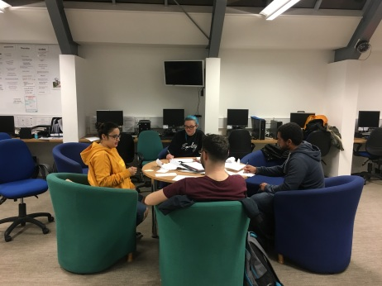
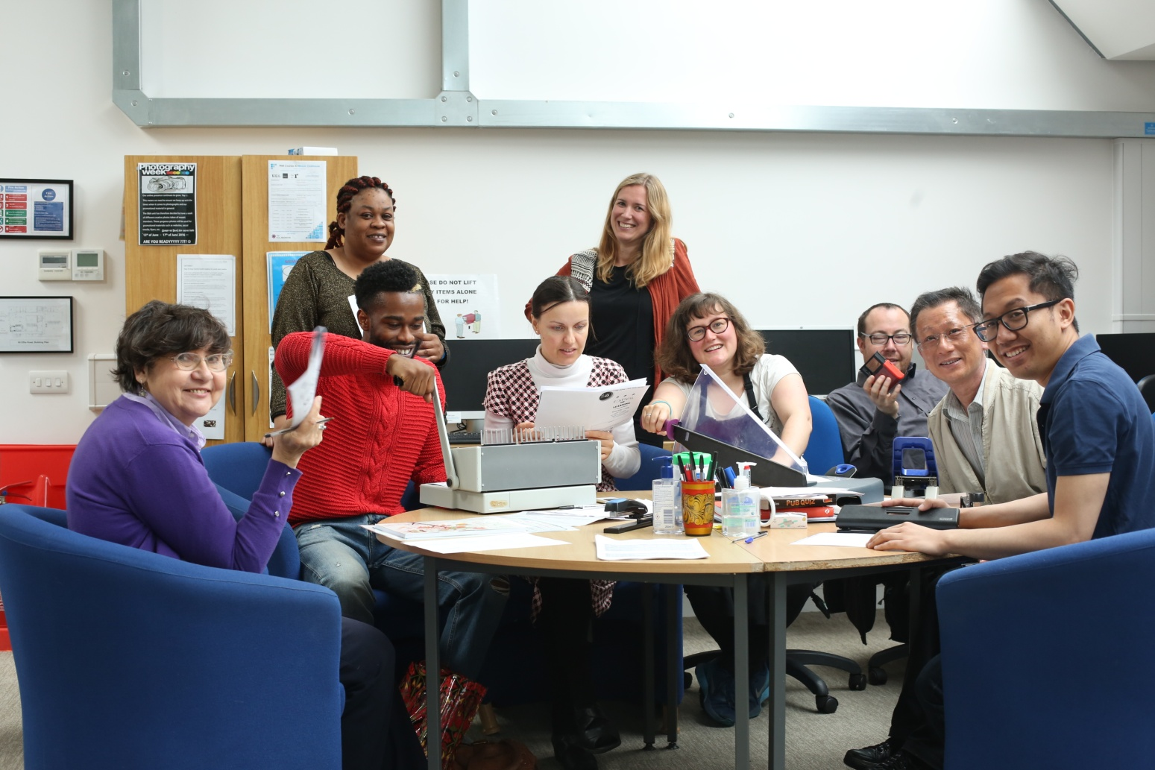

Virtual Mosaic
Community of Mutual Support
Zoom Unit Meetings - Mosaic operations, ideas, encourage unit work at home, space for members to meet, see each other and socialize.
YA committee meetings
Policy Meeting
Writing Club
Film Club
Yoga (open to non members)
National Careers Service (open to non members)
Mosaic Information Hub Phone or Text: 07984 343 643.
Email: infohub@mosaic-clubhouse.org
Notes:
Virtual Mosaic & maintaining community of mutual support
Contact us through info hub and we can book in/sign up for national careers service and yoga

Slide 4

In the Mo
Members’ experiences
Clubhouse International
Share ideas support, wellbeing tips
Photography/artwork
Reviews books, TV, films, podcasts
Pixel FM https://www.spreaker.com/show/pixel-fm
Recipes
Poems, short stories
Employment – National Careers Service
Online Educational Courses – SLAM Recovery College, Open University
Other local services & support
Please sign up to our E-Newsletter
Nancy
n.holden@mosaic-clubhouse.org
Mosaic Information Hub Phone or Text: 07984 343 643.
Email: infohub@mosaic-clubhouse.org

Slide 5

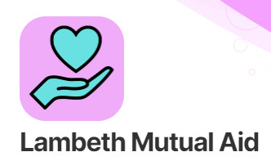









Further Support & Helplines
dragoncafe.co.uk
Connect and Do Virtual Programme
Solidarity in a Crisis Helpline
Lambethmutualaid.co.uk
0800 009 6504
0203 906 7676
listeningplace.org.uk
The Mix Helpline for YA
(Under 25)
08088 808 4994
themix.org.uk
Young Minds Parents Helpline
0808 802 5544
youngminds.org.uk
leaplambeth.org.uk
24 Hour Helpline for Older People
0800 4 70 80 90
www.clearcommunityweb.co.uk
SLAM Crisis Line 24 Hours
0800 731 2864
Carers Hub Lambeth
0207 501 8970
Mosaic Information Hub Phone or Text: 07984 343 643.
Email: infohub@mosaic-clubhouse.org
Please sign up to our E-Newsletter - Nancy
n.holden@mosaic-clubhouse.org
Notes:
Further Support & Helplines
All these services you can self-refer:
Certitude – Virtual Connect and Do (Art Monday, Choir, Laughter Yoga, Craft Group and Wellbeing Group)
Leap Lambeth - zoom coffee morning parents and children
Dragon Café – Monday Zoom wellbeing activities
The Listening Place – Emotional Support Telephone Service -0203906 7676
Clear Community Web Tech Support and online classes
Silverline – 24 Helpline for older people, might be able to link people up with local befriending services
Young Minds – YA Mental Health Charity, Good website, Parents Helpline
The Mix- helpline, great website, also run telephone counselling service for YA
Lambeth Mutual Aid – Register as a volunteer or ask for help(shopping, medicine, dog walking, using technology, phone call company)
SLAM – 24 Hour Mental Health Crisis Line
Carers Hub Lambeth, Virtual Groups, mindfulness, peer support groups and bingo

