Slide 1

Fast Forward:
The Collaborative 2015 and beyond

Slide 2
Agenda
1. Updates from Key transformation programmes (1.00 – 1.45pm)
Introduction - Cllr Dickson (Cabinet Lead for Health and Wellbeing)
Overview of System Change - Ray Walsh (CCG clinical commissioning lead) and Denis O'Rourke (Assistant Director Integrated Commissioning)
Updates
A Community Connector Story
  Black MH Commission - Cllr Edward Davie
  Sue Field and Stacey Hemphill – The LWN
  Adult Mental Health Redesign (SLaM) - Fran Bristow (Programme Director)
2. Transformation and Innovation Market Place (1.45 – 2.45pm)
Choose 3 market stalls during this time and listen to a speech for 10 mins then a 5 min Q&A session.
3. Tea and Coffee Break (2.45 – 3.05 pm)
4. Living Well Lab (3.05 – 4.45pm)
All participants to take part in 1 of the following:
GROUP A: Business challenges: calling all entrepreneurs - Facing resource challenges under the topics of 1) Pet support, 2) Flat cleaning, 3) DIY service
GROUP B: Growing, Evolving and extending the Collaborative: Taking the Medication Prototype, Peer Support & Connecting Communities to scale - Supporting the growth and continued co-design and co-delivery of new services and cultures
GROUP C: Back to the Living Room - Disruptive system change… What if there was only one hospital ward in Lambeth?
5. Feedback from group lead facilitators (4.35pm – 4.45pm)
6. Close (4.45pm – 5.00pm)

Slide 3
Councillor Jim Dickson
Cabinet Lead for Health and Wellbeing

Slide 4
Dr Ray Walsh
CCG clinical commissioning lead
Denis O'Rourke
Assistant Director Integrated Commissioning

Slide 5
Taking coproduction to the next level
System wide transformation

Slide 6

Our Collaborative Journey
June 2010:
Lambeth Living Well Collaborative established
March 2011:
Range of new initiatives commence
Innovations already in place
Community options service - 350 people supported
Primary care support team - 150 people supported
SWOT team developed by social care
Range of peer support initiatives - 600 people contacts
Connecting people initiatives
Living well partnership resource centre
Personal health budgets - 110
Multi agency workforce development via the Living well network hub
One system wide recovery and support plan
September 2011:
Provider Alliance Group established
November 2013:
LWN commenced
Next steps
Grow innovations to scale – peer support, connect and do, personal budgets etc
Implement LWN across the borough
Implement SLaM AMH remodel
Implement alliance contract framework to support transformation– - Sept 2014
Workforce development and culture change
April 2014:
System change

Slide 7

Outcomes – must represent value to all
The Big 3 outcomes developed by Lambeth Living Well Collaborative:
Recover and stay well
Make their own choices & achieve personal goals
Participate on an equal footing in daily life
Plus other outcomes that matter:
Social Value
Cost
Safety
Clinicians
Public Health
Primary Care
SLaM
THE COLLABORATIVE
Commissioners
People who
use services
Carers
Voluntary Sector Providers

Slide 8
Outcomes and objectives
Recovery and staying well
Improved mental health wellbeing
People’s physical health has been addressed and managed
Reduced unplanned use of services
Own choices
People live in a place of own choosing
People use personal budgets
Participation
More people are in employment
All take part in meaningful activities
Social value
Improved overall value to community
Cost
Actual costs are equal to or less than target costs
Safety
Reduced incidents of safeguarding, self harm and crime

Slide 9

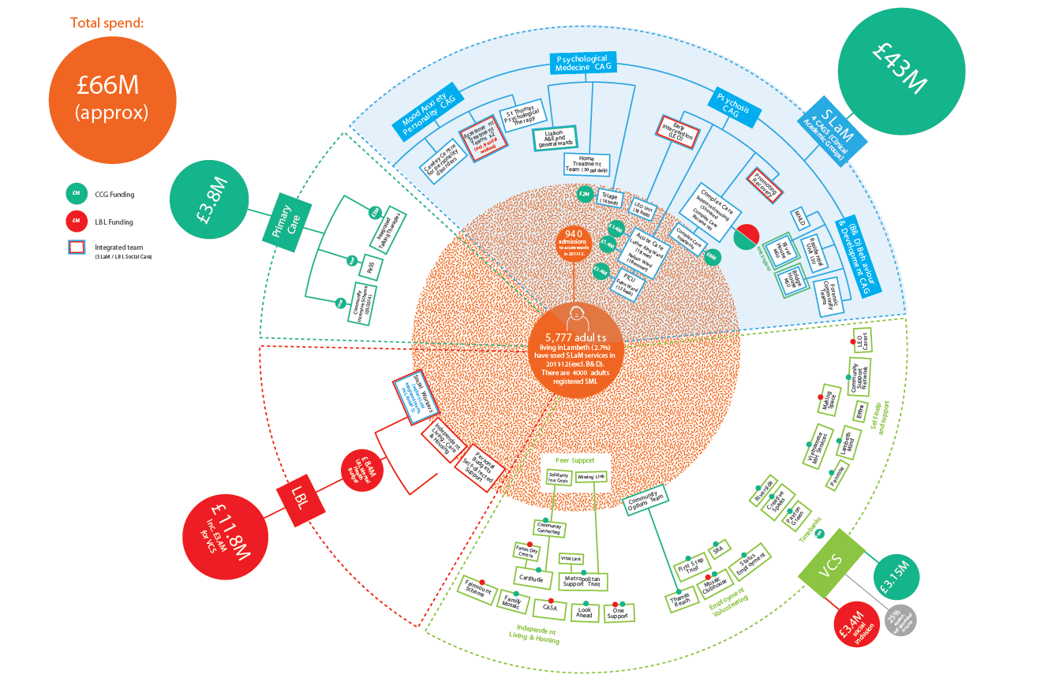
Fast Forward: The Collaborative 2015 and beyond

Slide 10
Investment shape – now and future

Slide 11
Next steps
Grow innovations to scale – peer support, connect and do, personal budgets etc
Implement LWN across the whole borough
Implement SLaM AMH remodel
Implement alliance contract framework to support integration and transformation - Sept 2014
Workforce development and culture change

Slide 12
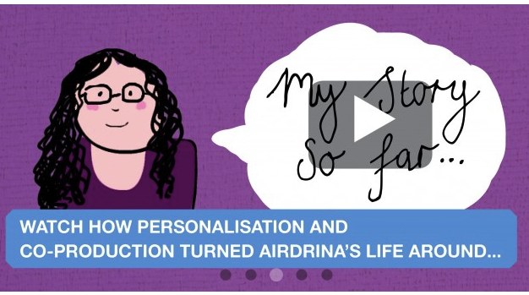
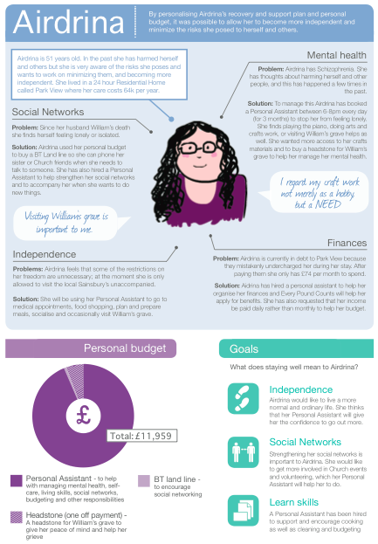
Meet Airdrina…
Institutional living circa £60k support
A life of her own and personalised support £11k

Slide 13
Airdrina’s story
http://lambethcollaborative.org.uk/recoverystories/airdrina%E2%80%99s-story-integrated-health-and-social-care-personal-budgets

Slide 14
Rina Deans
Community Connector

Slide 15

Community Connecting
Small interventions that can make life-changing differences..

Slide 16
Community Connecting
Focuses on helping people to develop and build stronger relationships with friends and families
It connects people together around shared interests so that people are motivated to stay involved in the activity and connected with each other

Slide 17

Week 1: Introductory Meeting
I met Jane in the local café
Jane wants to be a physiotherapist.
We looked at the Connect and Do website.
Found a dance group near her house.

Slide 18

Week 6: Mid Review Meeting
Regularly attending dance class and connecting
Next steps: to attend women’s coffee meetings in order to build confidence and networks
Jane found a lunch club at the local church to attend on the Connect and Do website.

Slide 19

Week 12: End Meeting
Jane is now attending dance group, women’s coffee meeting, lunch club and bible study in the local church.
She has gained confidence and is happier to be with her friends in her local community.

Slide 20
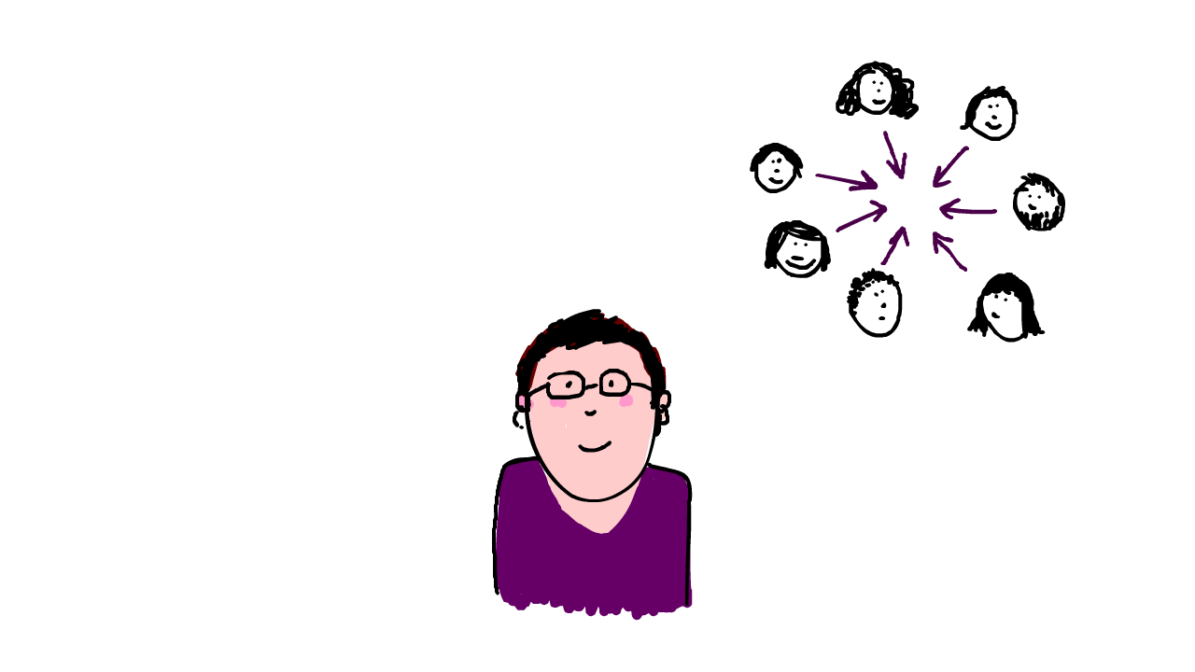
Jane’s Comment
My coach understood my difficulty of why I was isolated and helped me.
I am happier and more confident to go out to meet my friends.
I hope I can be a physiotherapist in the near future.

Slide 21
Councillor Edward Davie
Black Mental Health Commission

Slide 22
The North Lambeth Hub
Stacey Hemphill
Occupational Therapist / Practitioner
Sue Field
Programme Director, Provider Alliance Group

Slide 23
What is the Hub?
With GP Di Aitken
http://lambethcollaborative.org.uk/news/the-hub-is-here-for-north-lambeth

Slide 24
LWN Hub
Introduction vs. Referral
      Start of a conversation with someone and their support network
      Not just a list of clinical issues
      Saying yes rather than saying no
Co production
      Acknowledging people as having capabilities and assets – ‘can they do it for themselves’
      Bringing GP’s voice to the table
      Peers / COT / Pass / Triage challenging past thinking by who is around the table
      Shared knowledge and thus responsibility
      Living Well Network

Slide 25
LWN Hub
        12 week offer
      Time to do and think
      A coaching rather than clinical expert intervention
      Goal orientated – outcome focussed
      Personalisation – asset focussed, skill building
      New tools and resources -Personal health budgets, different knowledge
      Personal reflections
      Our past responses have built a high wall around support
      If we take down the wall, how do we provide enough service

Slide 26
Key targets - within three years
Reduce the number of people managed within A&T by 25%
Reduce the number of people case managed by R&S by 50%
Divert 1000 people to the new offer.

Slide 27
Next steps
Strategically
Guys and St Thomas’ Charity
    Consolidate work of the North Hub
    Roll out to South
    Pilot self referral
Develop a Community Incentive Scheme with GPs and the Hub (CIS)
Mainstream Medication Management Prototype
Develop a system wide coproduction culture change programme including a Peer Support Exchange Network.

Slide 28
Fran Bristow
Programme Director, SLaM
Adult Mental Health Development Programme

Slide 29
The AMH Model – 3 main elements
A more robust front door
  with higher quality assessments, extended hours and a more seamless pathway between services to ensure people get the right help at the right time, to improve the efficiency of SLaM services – including “easy in” and reduce the reliance on bed based services
Reducing relapse rates
  This will include reducing caseloads to enable more effective engagement; increasing the availability of proactive interventions to prevent or minimise crises, which might sometimes involve admitting patients to hospital earlier;, but for a shorter time and reducing length of admissions by supporting discharge planning and coordination – including peer support networks
Transferring more stable patients to primary care
  supporting individual’s recovery and working with the networks community offer to enable people to stay well

Slide 30

Transformation and Innovation Market Place

